Slide 1

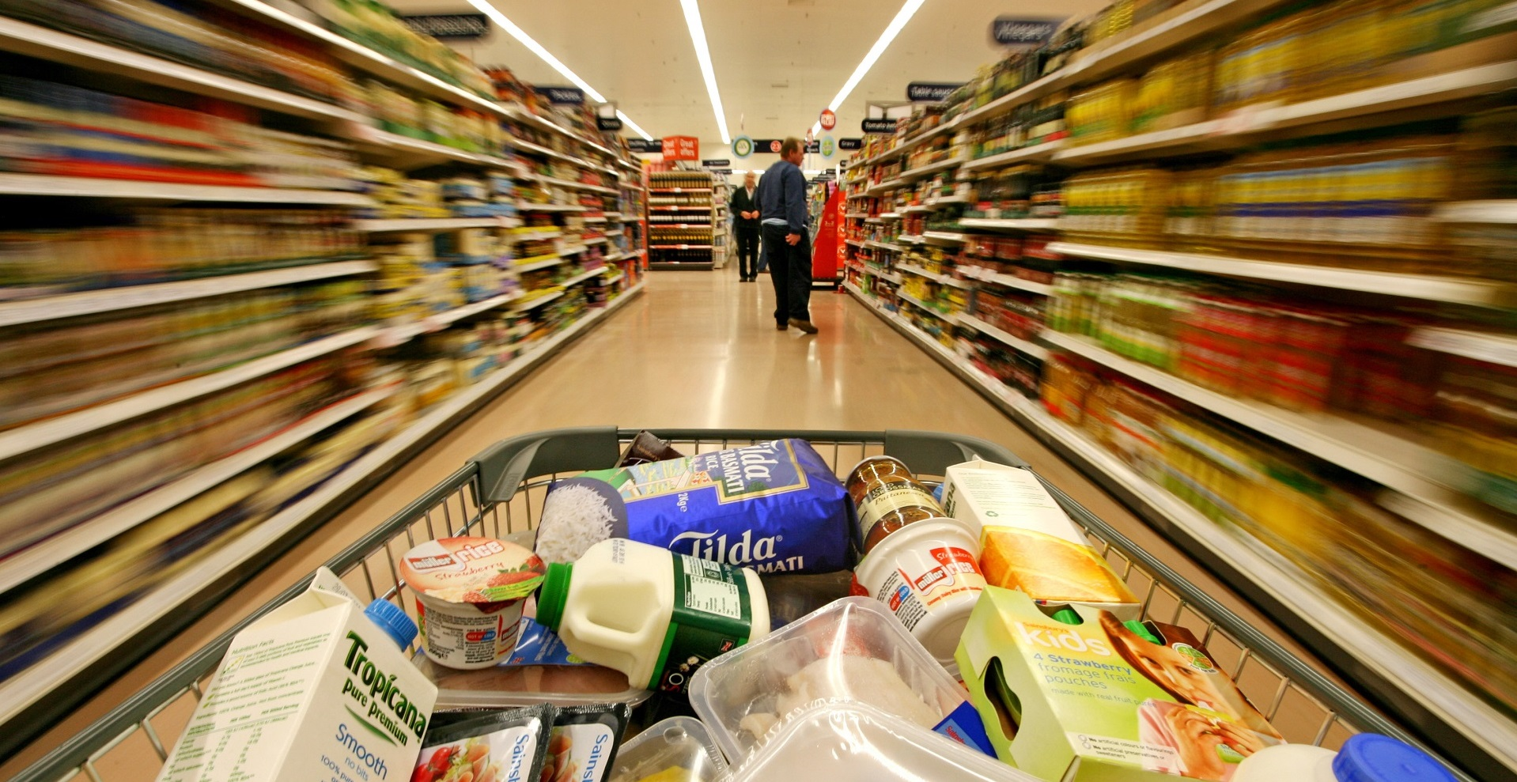

recommender system
FMCG WHOLESALE TRADING
DSI Capstone Project – Cheyanne Wong

Slide 2


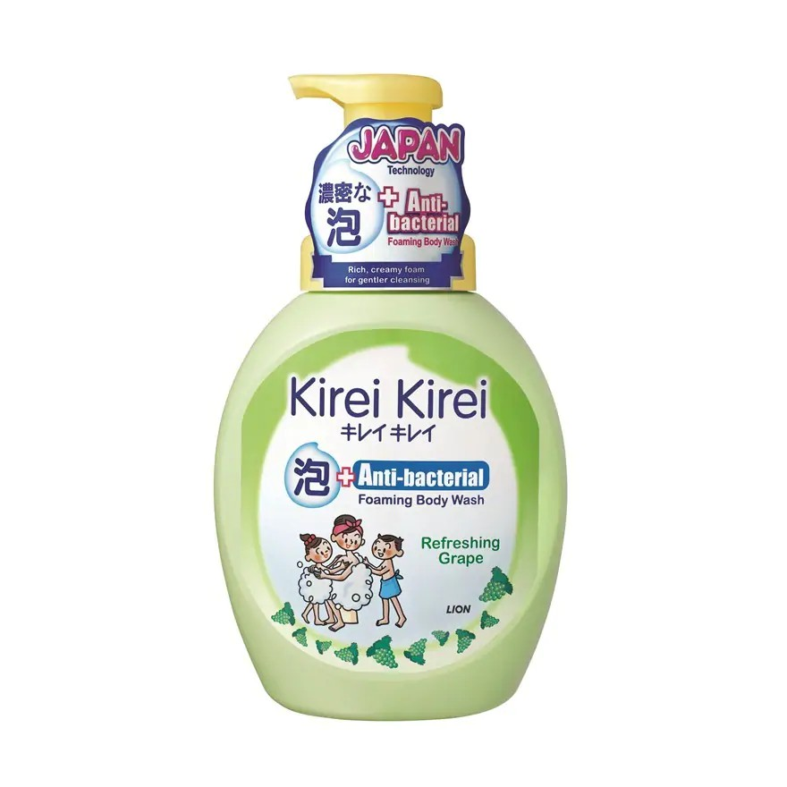
PROBLEM STATEMENT
Build a recommender system for their wholesale customers
Increase sales revenue through
quantity (sales volume)
profit margin
Case Study
Company: PINK BEAUTY
Item: Kirei Kirei Body Soap Refreshing Grape 600ml

Slide 3
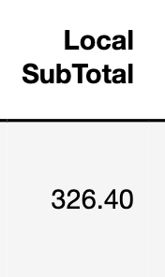
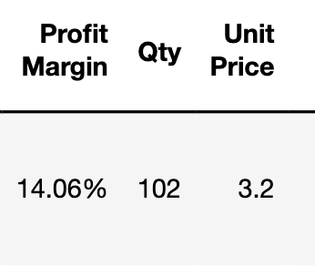
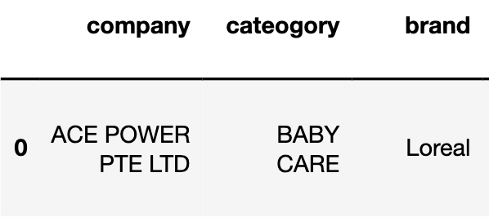
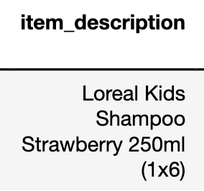
Dataset description
5585 rows
35 columns
No. of retail companies | 93
No. of brands | 81
No. of unique products | 549

Slide 4
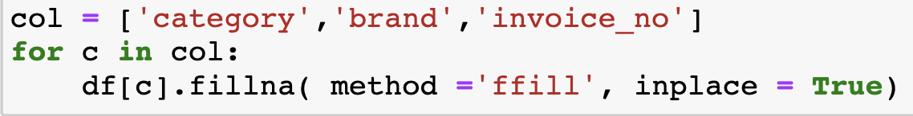
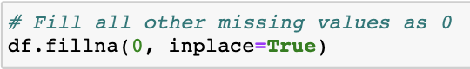
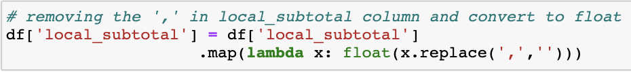
DATA CLEANING
95%
Forward Fill for
categorial features
Fill value as ‘0’ for
numerical features
Change datatype from
object to float/int
Drop rows with
no company / invoice no
Drop rows with
zero unit cost / unit price
Drop rows with
negative profit margin

Slide 5
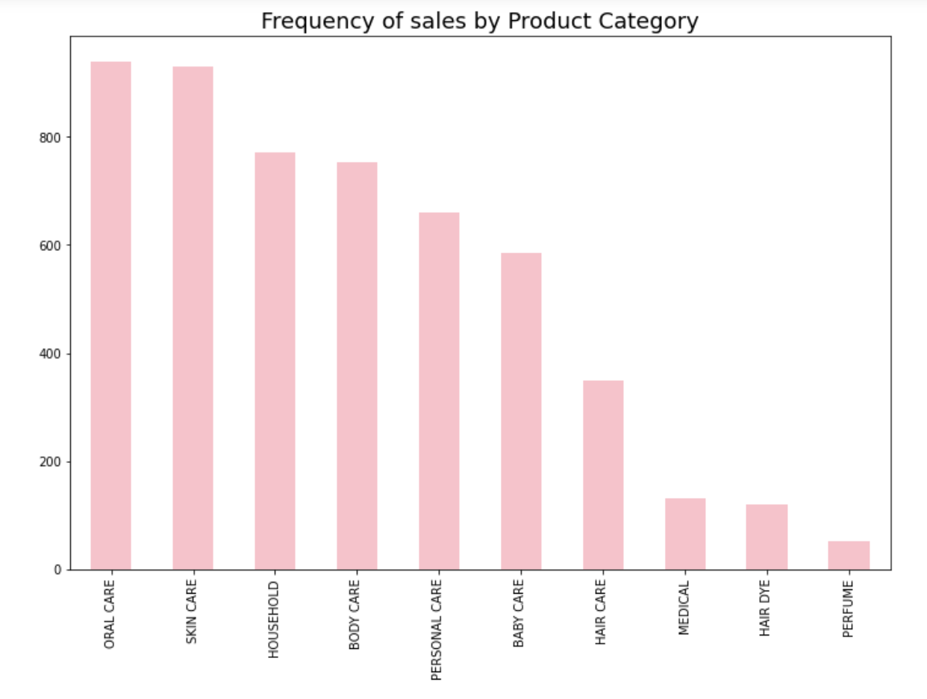
Frequency of Sales by Product Category
Exploratory data analysis
Frequency of Sales by product category

Slide 6
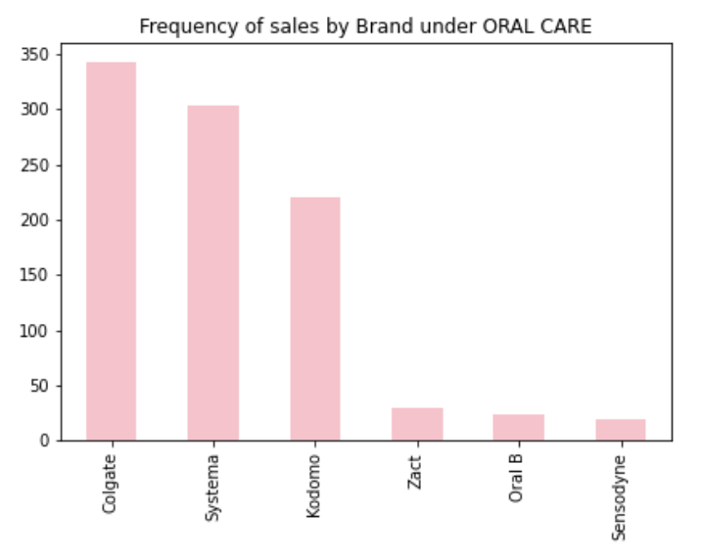
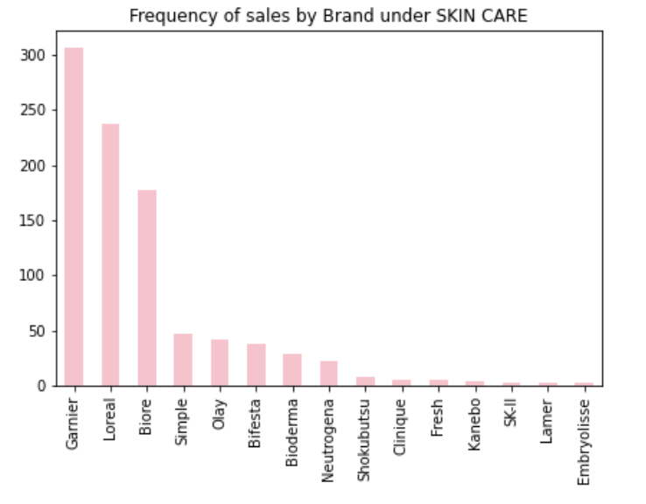


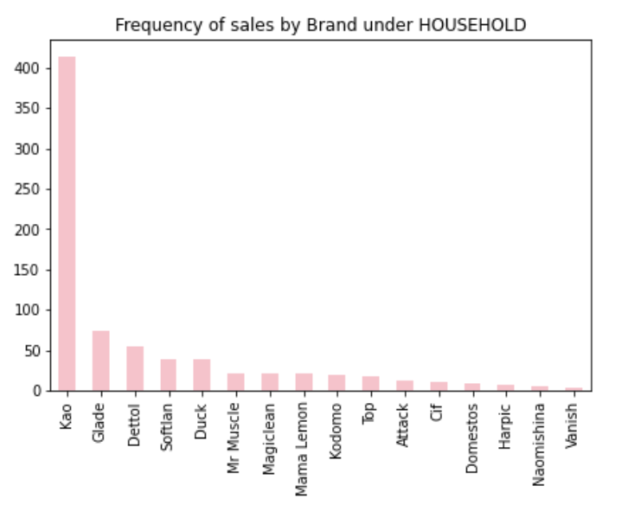
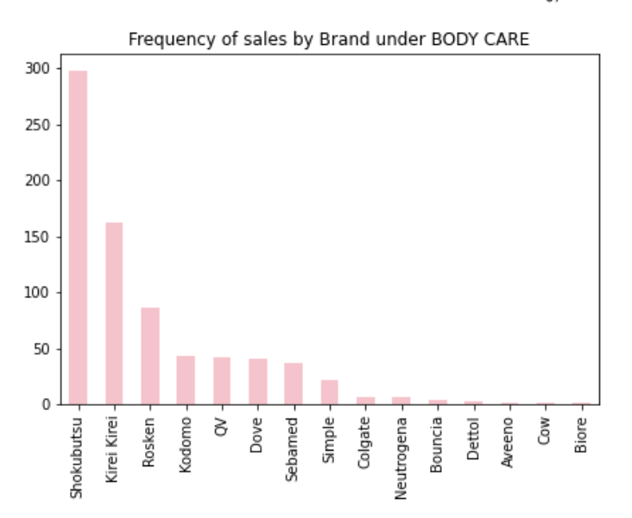


Frequency of Sales by Brands
Exploratory data analysis
Frequency of Sales by brands

Slide 7
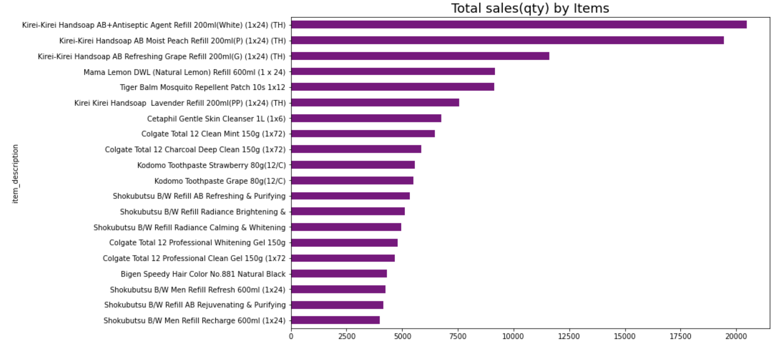
Total Sales (Qty) by Items
Exploratory data analysis
TOTAL Sales (QTY)by items

Slide 8
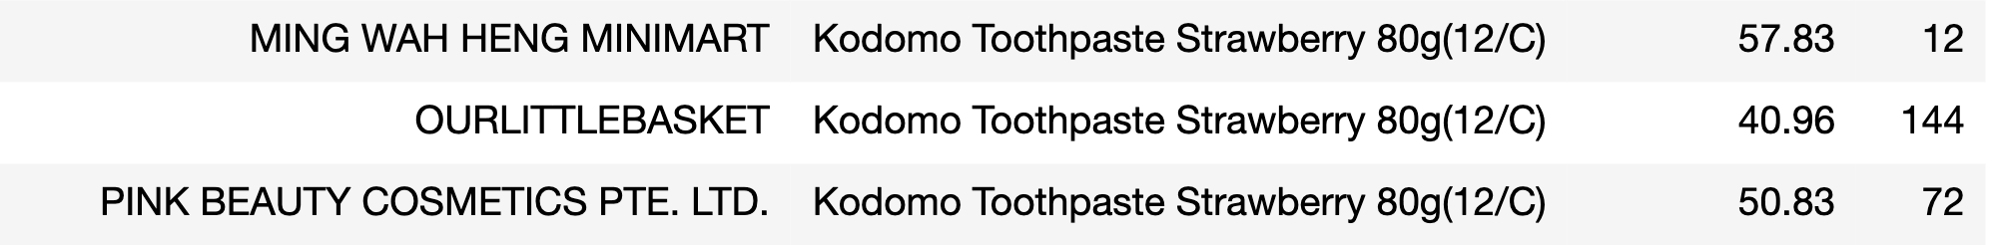
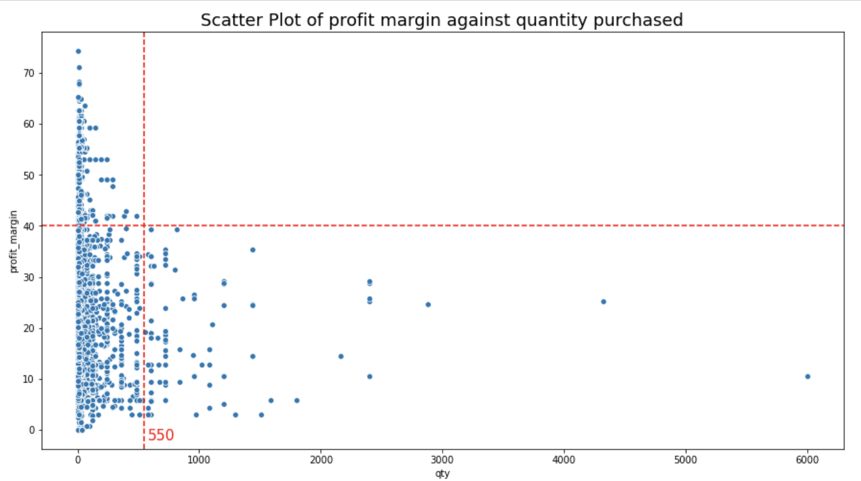
Exploratory data analysis
Profit margin VS QTY
Qty Profit margin

Slide 9
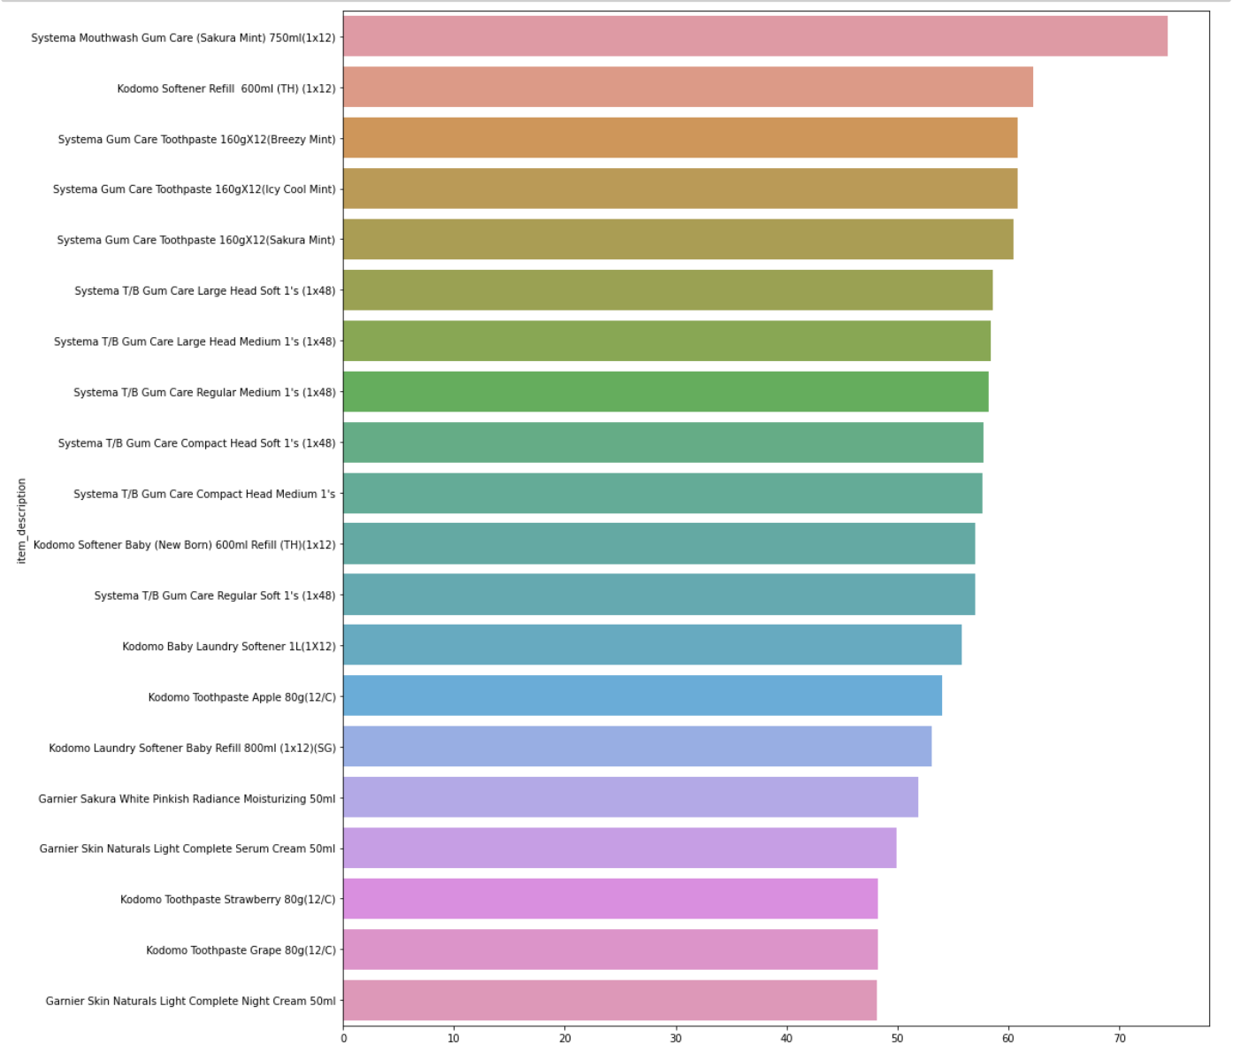


Exploratory data analysis
Top 20 Items with High Profit Margin
HIGH Profit margin ITEMS

Slide 10
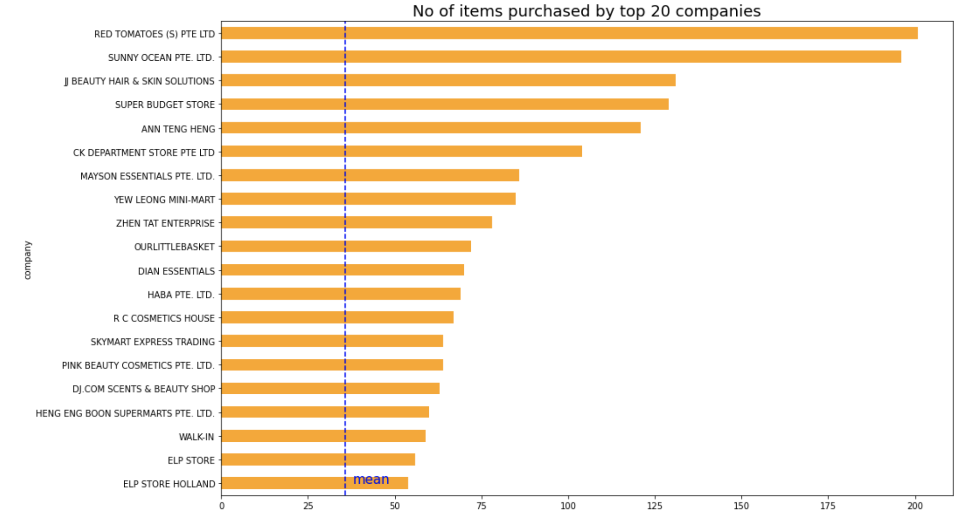
No. of items purchased by top 20 companies
Exploratory data analysis
No. of items purchased
35.7

Slide 11
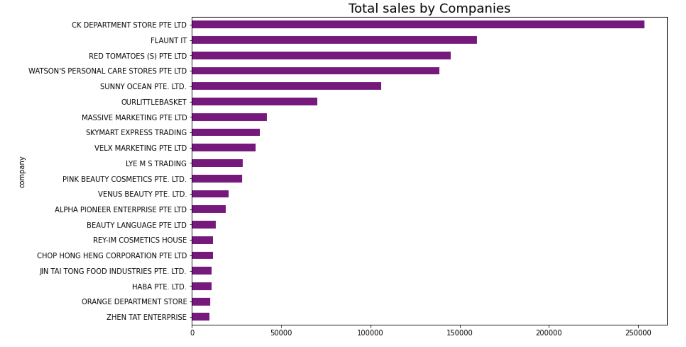
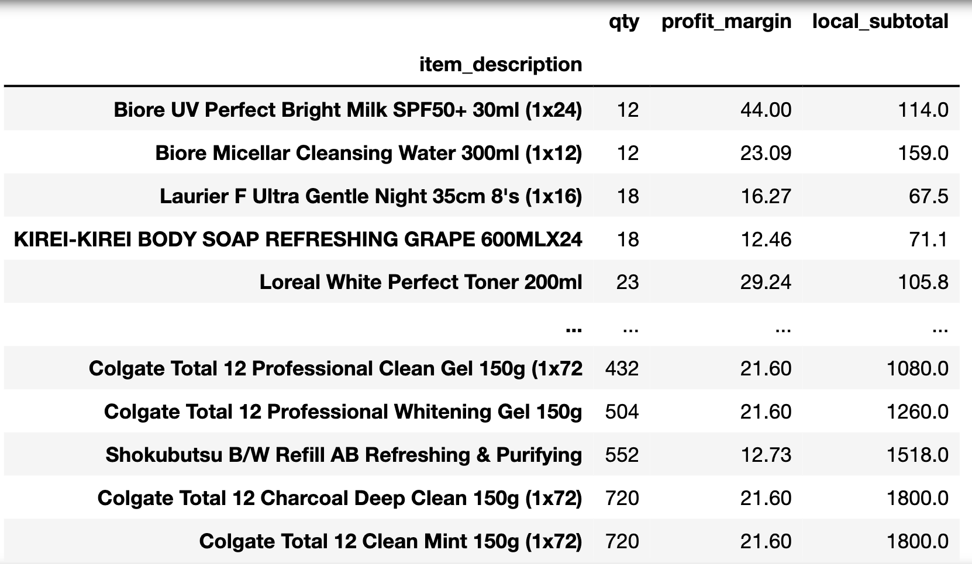
CASE STUDY
PINK BEAUTY COSMETICS PTE LTD
64 items purchased
MONTH | SALES AMOUNT
July | $14,385.86
August | $10,625.02
September | $ 3,222.00

Slide 12


RECOMMENDER SYSTEM
popularity model
Content based filtering
USER-based collaborative filtering
Collaborative Filtering with SVD
Hybrid model

Slide 13
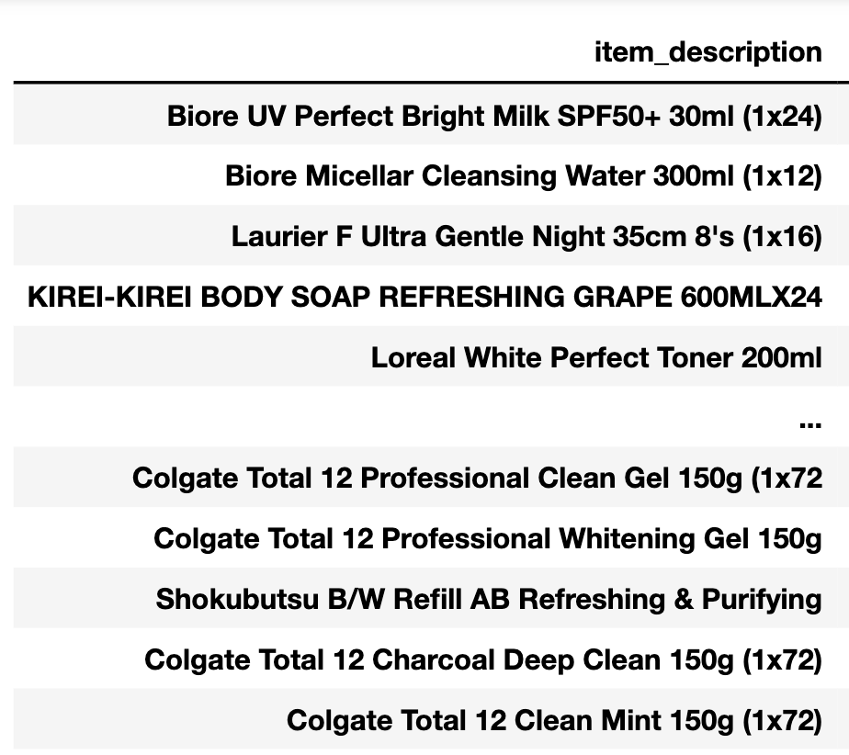
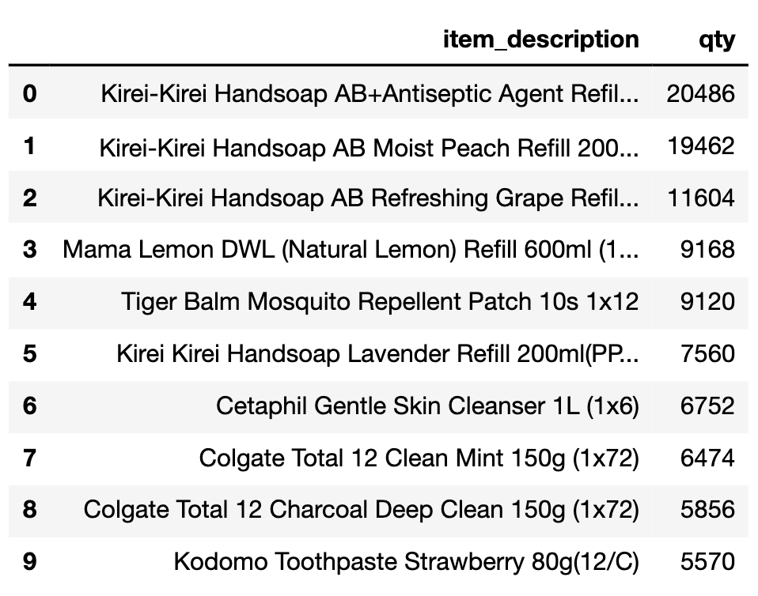
popularity model
Items purchased by PINK BEAUTY (64 items)
Most popular items sorted by QTY

Slide 14
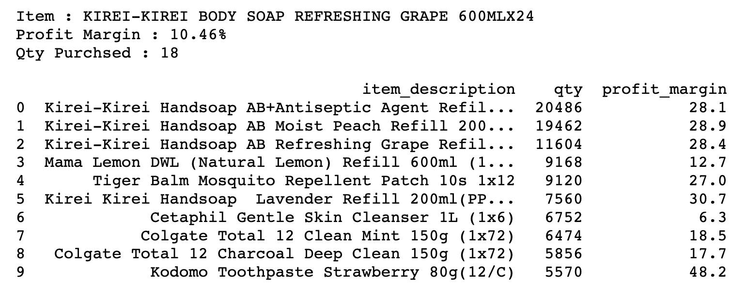

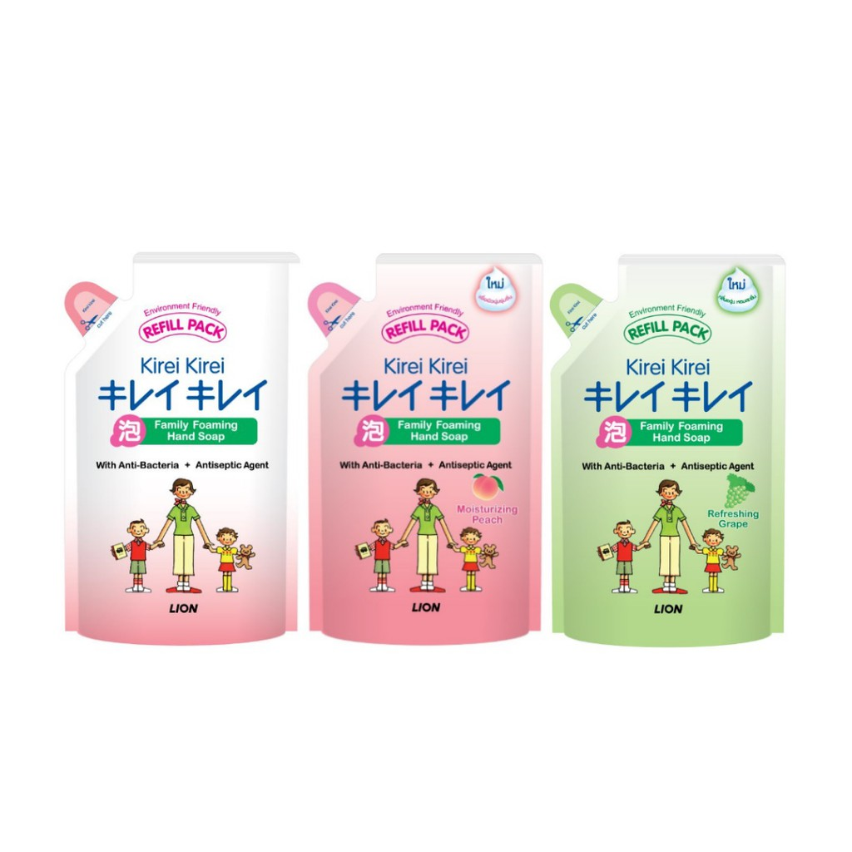
popularity model
Recommended Items:

Slide 15
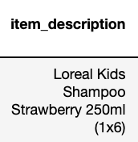

content based filtering
Item
Item Features
Size | Category | Sub-category
 | Oral Care Body Care Hair Care Skin Care Household Baby Care Medical Perfume Personal Care Hair Dye | Shampoo Conditioner Toothbrush Toothpaste Spray Men Lotion Mouthwash Moisturizing . . .
Buy
User
Mini: < 100
Small: < 400
Medium: <1000
Large: < 3000
X-Large: >3000
Similar
Recommend
5 | 10 | 42

Slide 16
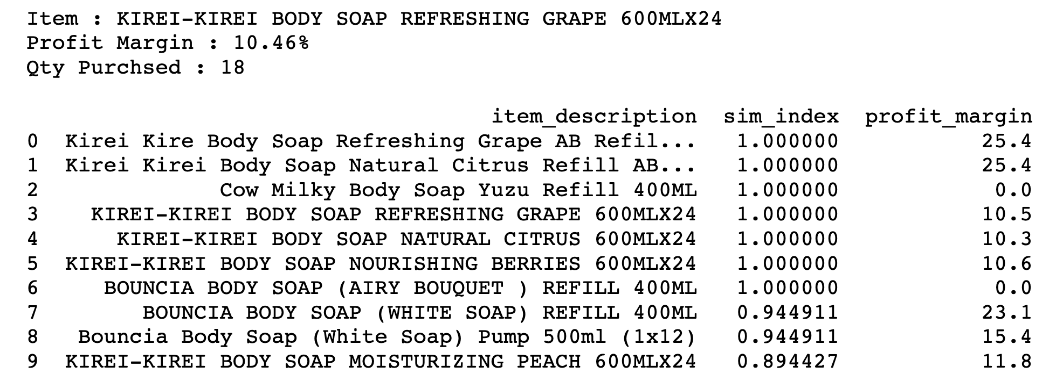
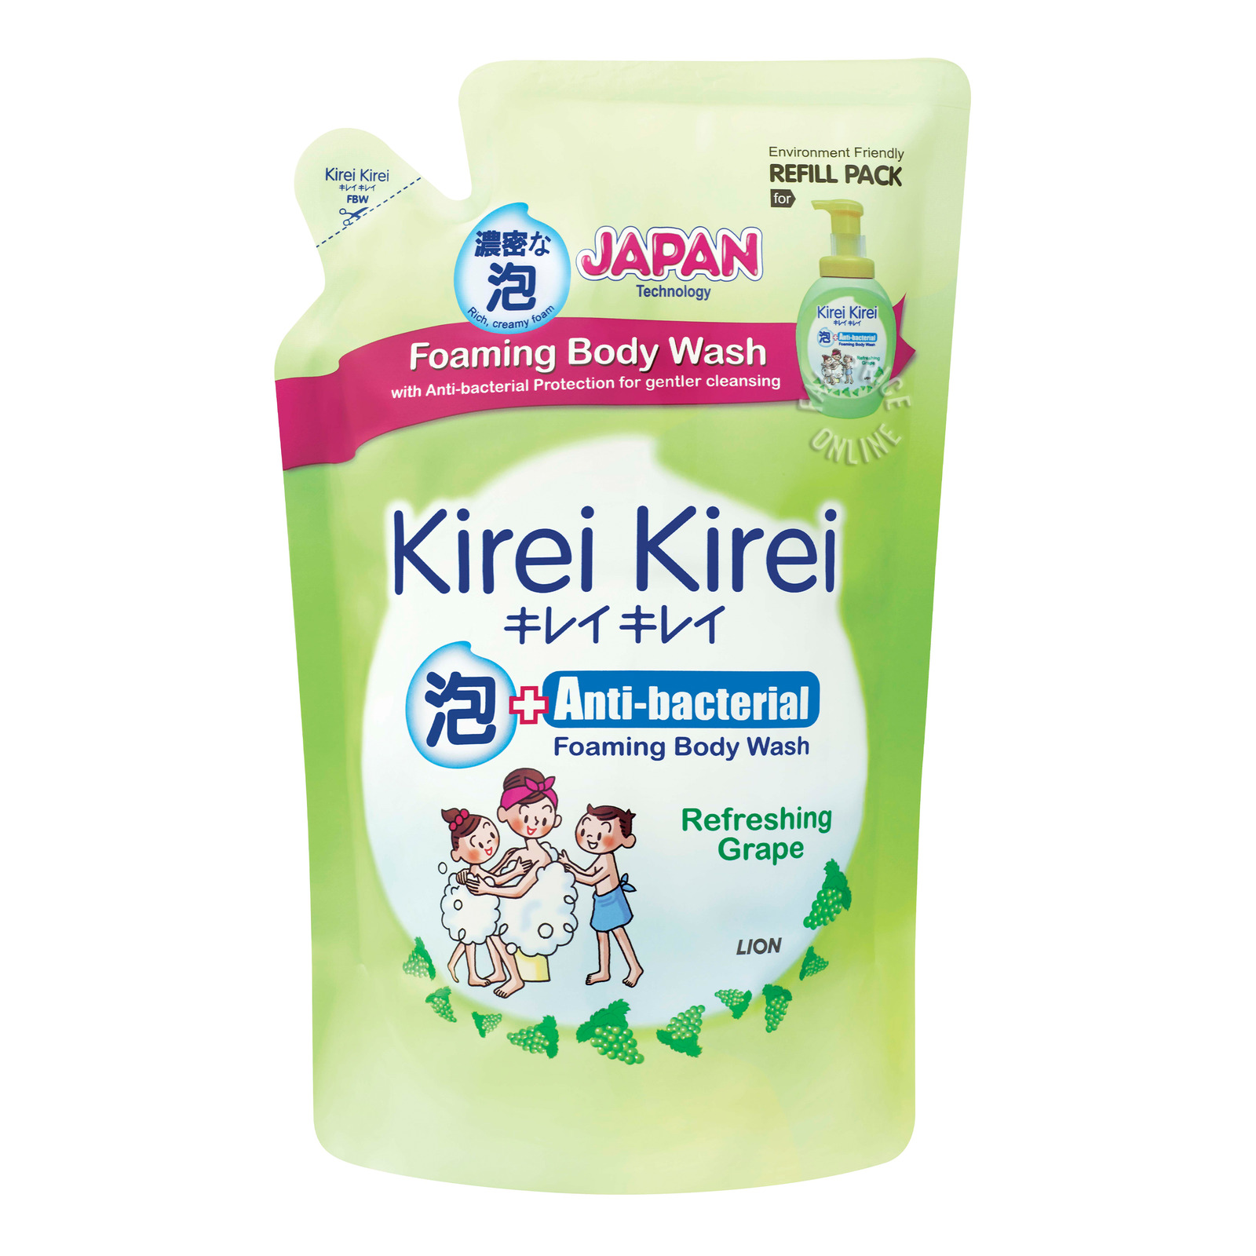
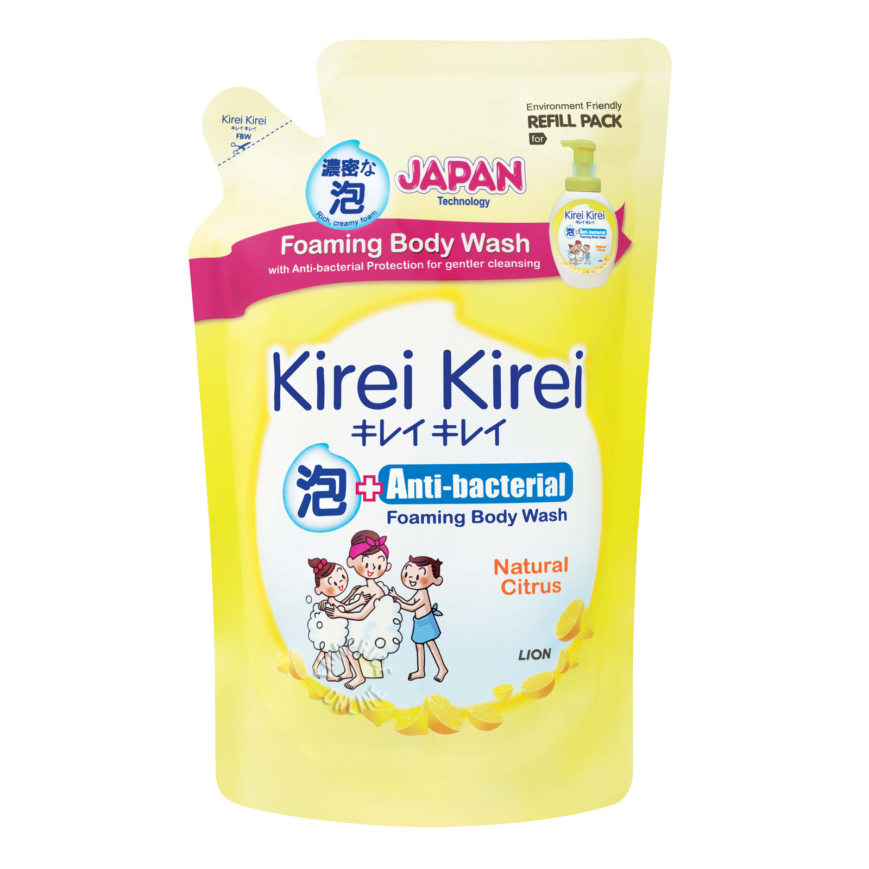
content based filtering
Recommended Items:
[Body Care / medium / body / soap]

Slide 17

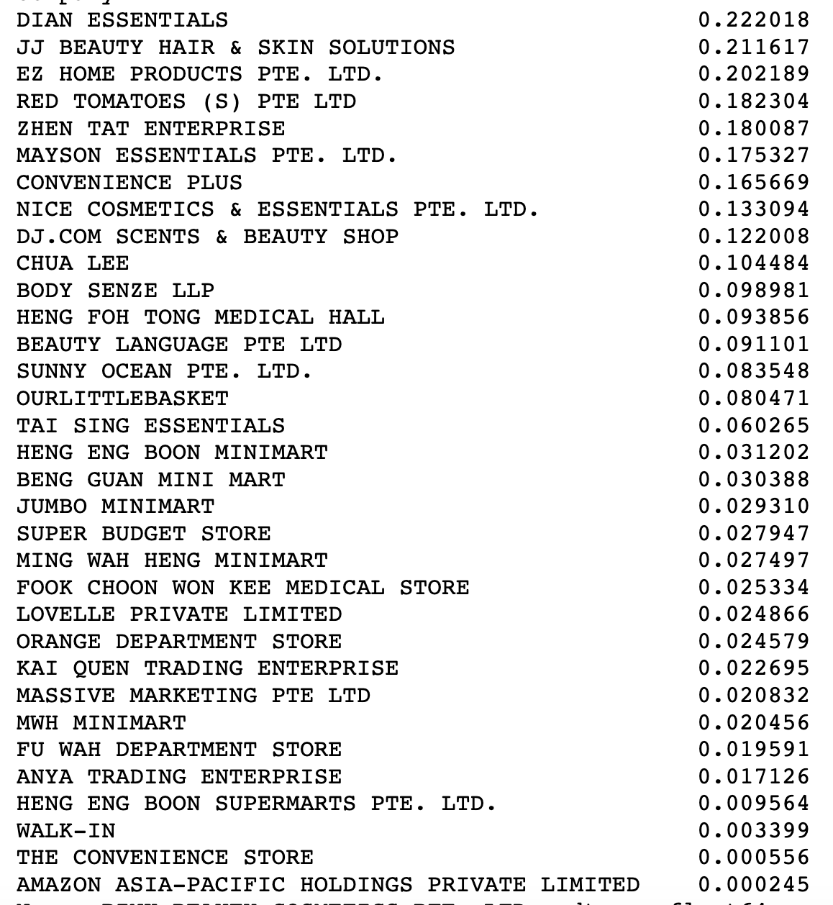

USER-based collaborative filtering
Implicit Ratings
Companies
Similarity score
Item Ratings
Ratings | Qty Purchased | Count
1 | < 10 | 1174
2 | < 20 | 1838
3 | < 30 | 739
4 | < 50 | 465
5 | >= 50 | 1074
Dian
Essentials
Similarity
score
Recommendation
Score

Slide 18
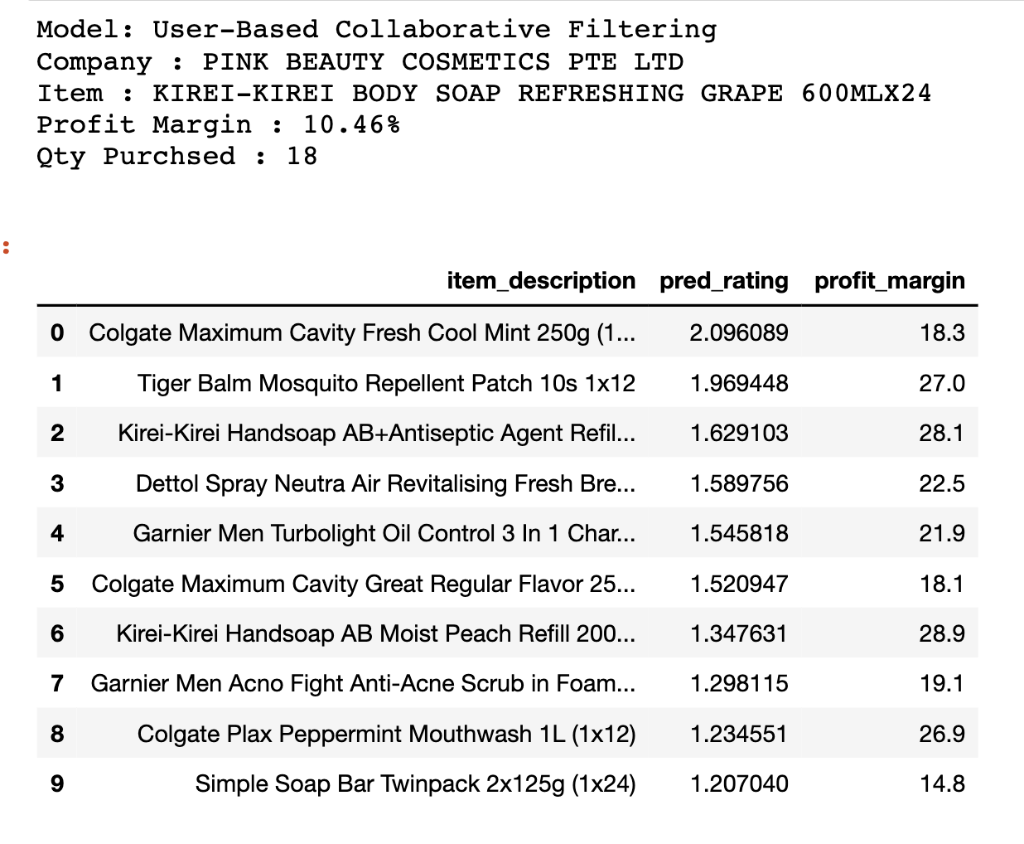
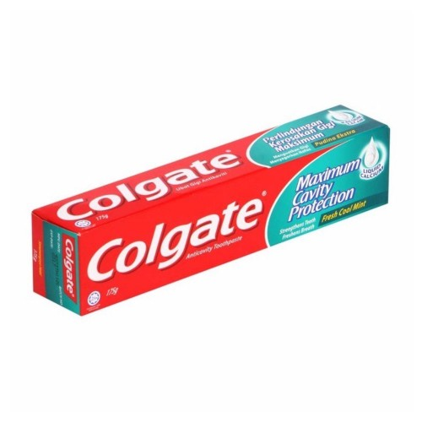
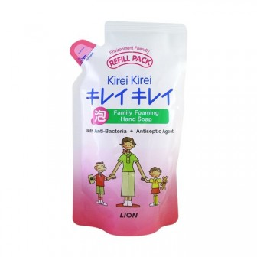
USER-based collaborative filtering
Recommended Items:

Slide 19
collaborative filtering with SVD
92 Companies
92 Companies
1,840 links
u
20 Features
sigma
48,576 links
528 Items
10,560 links
Vt
528 Items

Slide 20
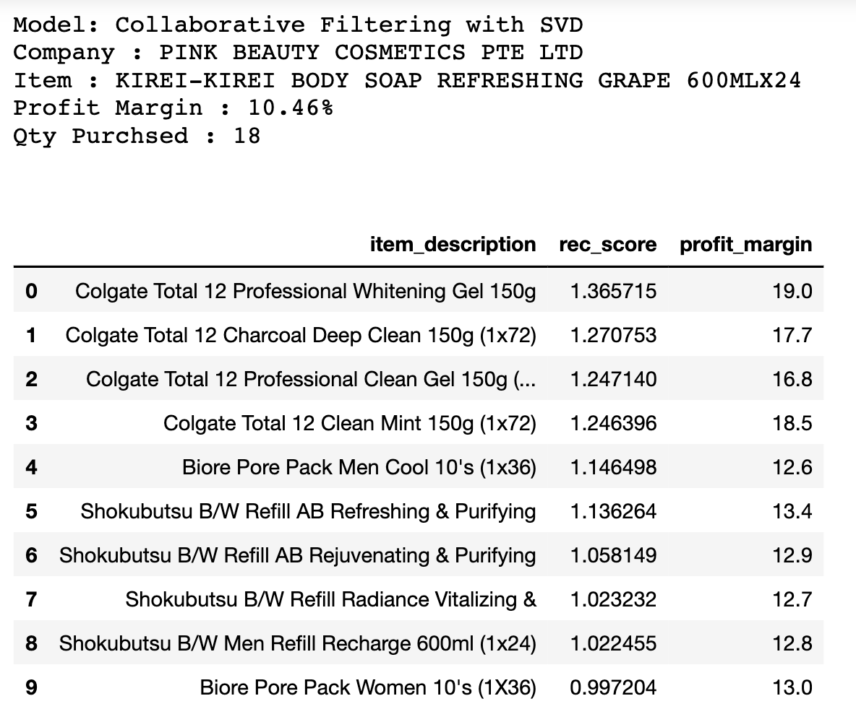



collaborative filtering with SVD
Recommended Items:

Slide 21
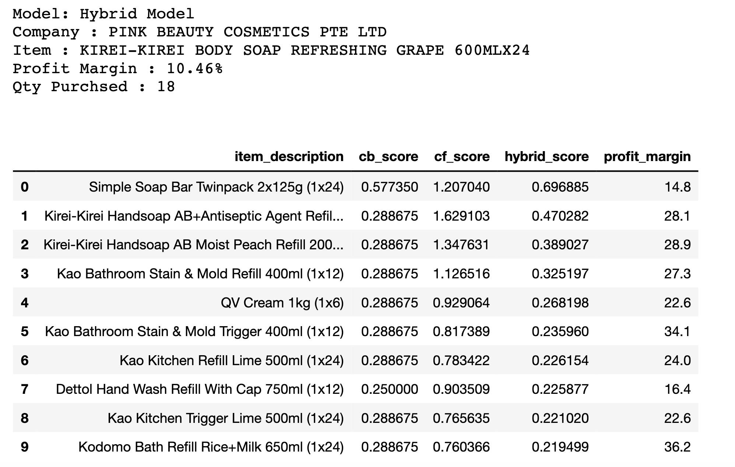
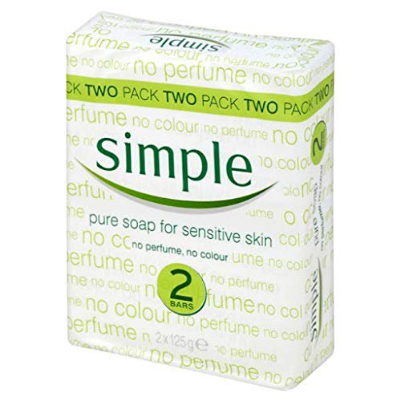
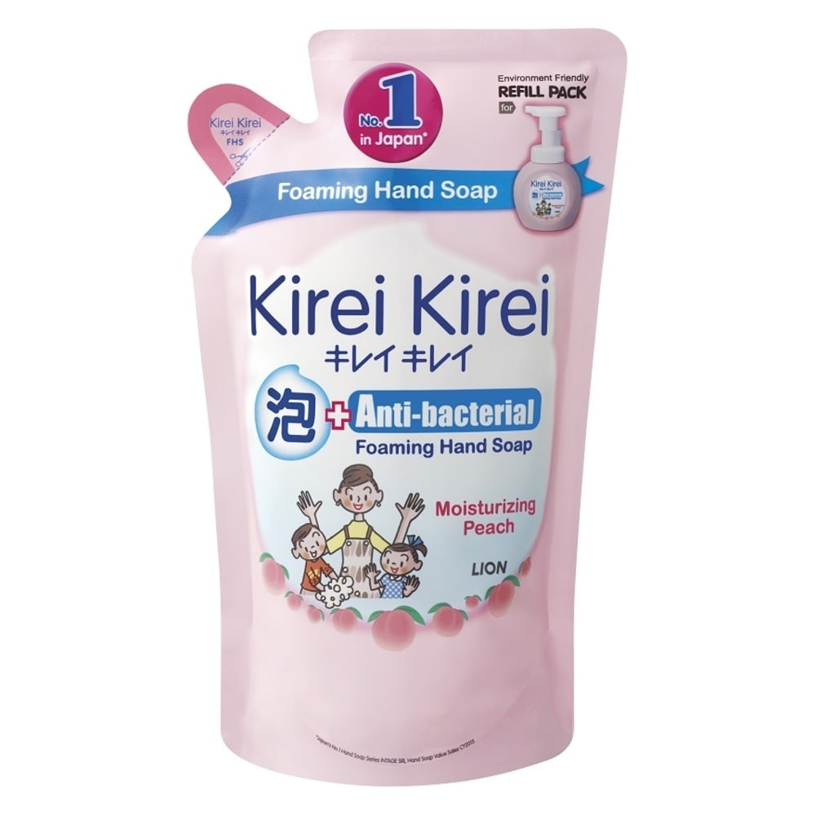
hybrid model
cb_score x cf_score
Recommended Items:

Slide 22
conclusion
MODEL | PROS | CONS
Popularity Model | - Easy to implement | - Lacks personalization
Content based Filtering | - Do not need information of other users - Able to identify specific interest | - Results are expected
User-based Collaborative filtering | - Identify new interests for users - No need for contextual features | - Cold-start problem
Collaborative filtering with SVD | - Reduce dimensionality | - Latent factors difficult to understand
Hybrid Model | - benefit from complementary advantages | - Too many variations

Slide 23

conclusion
Item Description | Popularity | CB | CF | SVD | Hybrid
Kirei-Kirei Handsoap AB+Antiseptic Agent Refill 200ml
Kirei-Kirei Handsoap AB Moist Peach Refill 200ml
Kirei-Kirei Handsoap AB Refreshing Grape Refill 200ml
Tiger Balm Mosquito Repellent Patch 10s
Colgate Toal 12 Clean Mint 150g
Colgate Total 12 Charcoal Deep Clean 150g
Simple Soap Bar Twinpack 2x125g

Slide 24
conclusion
Limitations:
Data is only available for July, August & September 2020
Inconsistency in data records
FURTHER RESEARCH:
Unit price as item features
Collection of additional data such as RSP of products
Trend of purchase over time
Reviews for products from consumers

Slide 25
THANK YOU

